Slide 1
Prostate Cancer Survival Analysis
VIGNESHWARAN GIRI VELUMANI

Slide 2
objective
Predict the 7-year survival of prostate cancer patients
GIVEN
Dataset containing 15385 Records of training data and predict 11531 Records of test data
Target (33rd Variable) – Survival_7_years : a binomial variable [1,0]

Slide 3
Approach
Typecast Variables (Numeric <-> Factor)
Create Derived Variables
Remove insignificant variables using
correlation plot and
subject matter expertise (internet research)
Use Training Data to build a Binomial Logistic Regression Model
Use the model to predict the test data

Slide 4
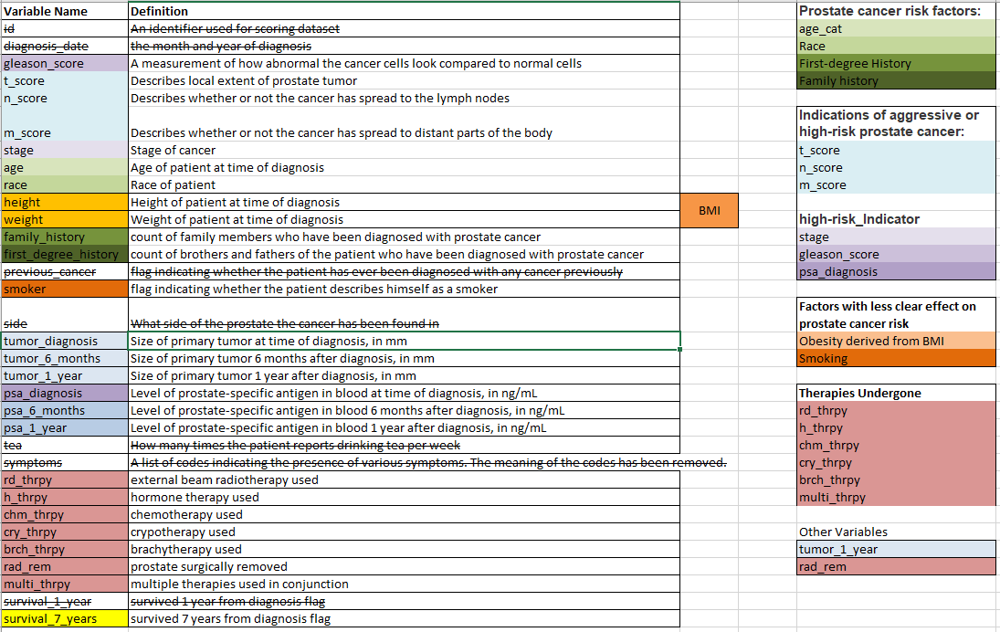
Blueprint

Slide 5
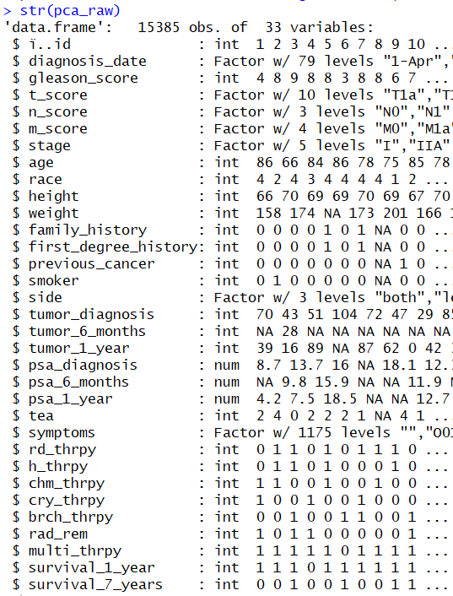
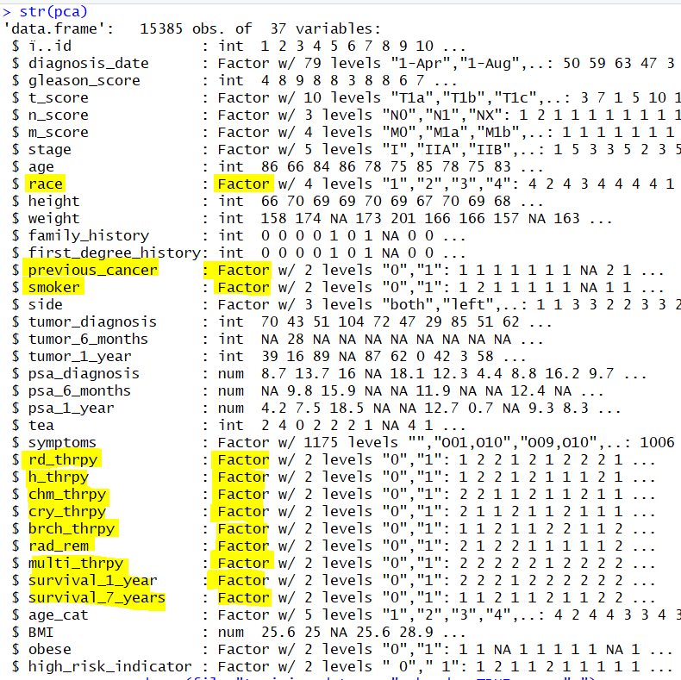
Typecast Variables (Numeric <-> Factor)

Slide 6
Derived Variables
Created Age_cat(Factor) variable from Age (Numeric)
Created BMI (Numeric) variable from Height & Weight
Created Obese(Binomial) variable from BMI
Created high_risk-indicator(Binomial) variable from
Stage = (III or IV) AND
gleason_score >=7 AND
psa_diagnosis >=10
Age_cat | Age Numeric
1 | 0-60
2 | 61-70
3 | 71-80
4 | 81-90
5 | 90+
Obese | BMI
0 | 0<=30
1 | 30+

Slide 7
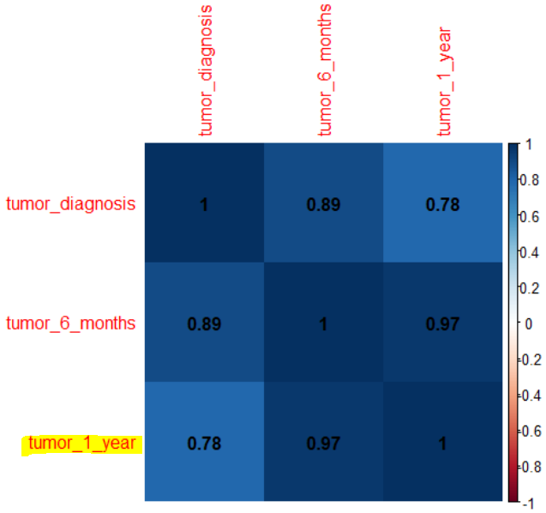
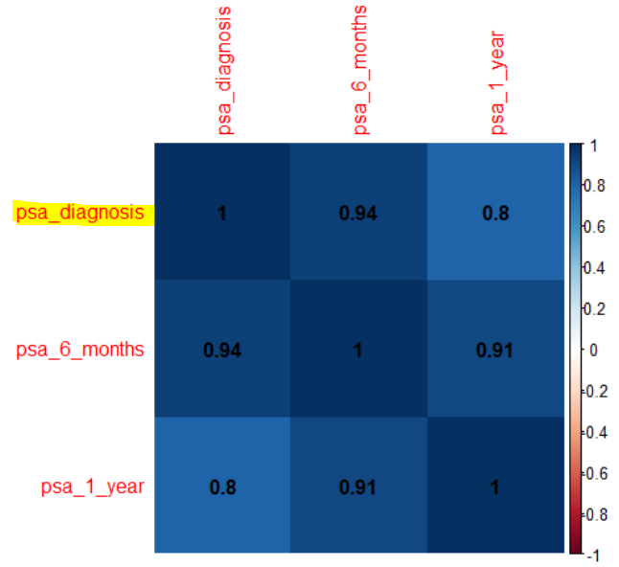
Remove insignificant variables using
Correlation plot
tumor_diagnosis | tumor_6_months | psa_6_months | Psa_1_year
Internet Research
diagnosis_date | previous_cancer | Side | tea | symptoms | Survival_1_year

Slide 8
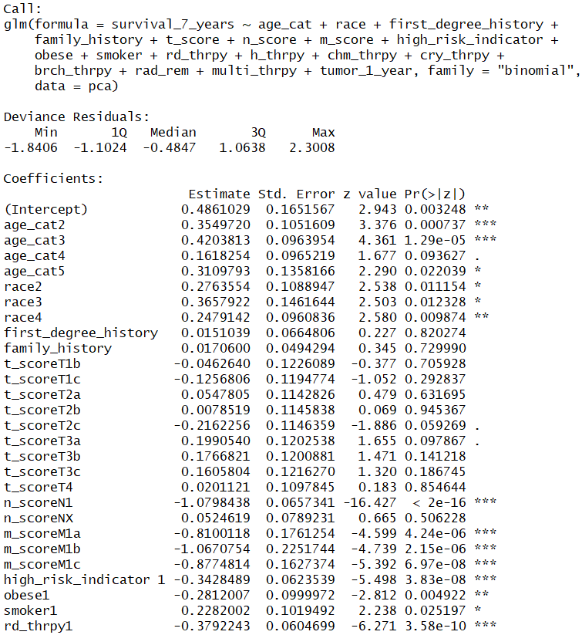
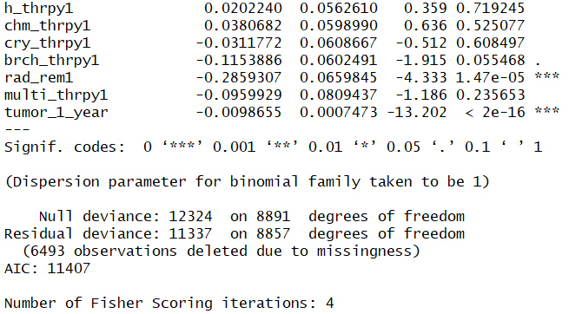
Logistic Regression Model

Slide 9
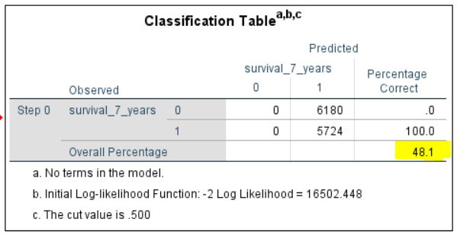
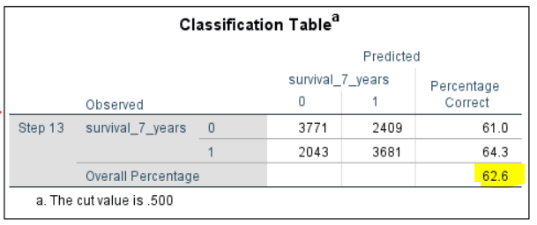
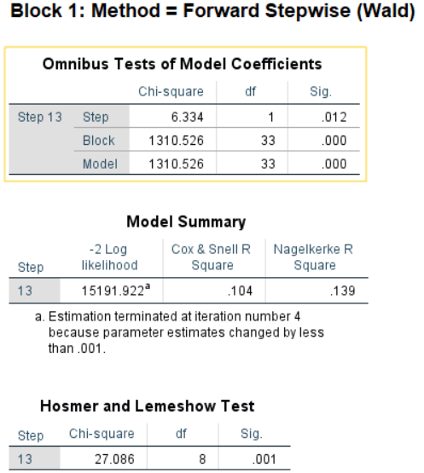
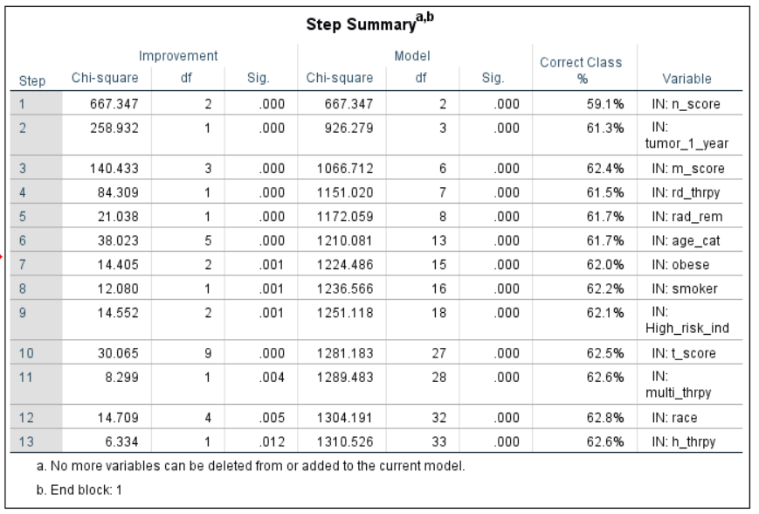
Forward Stepwise Logistic Regression:

Slide 10
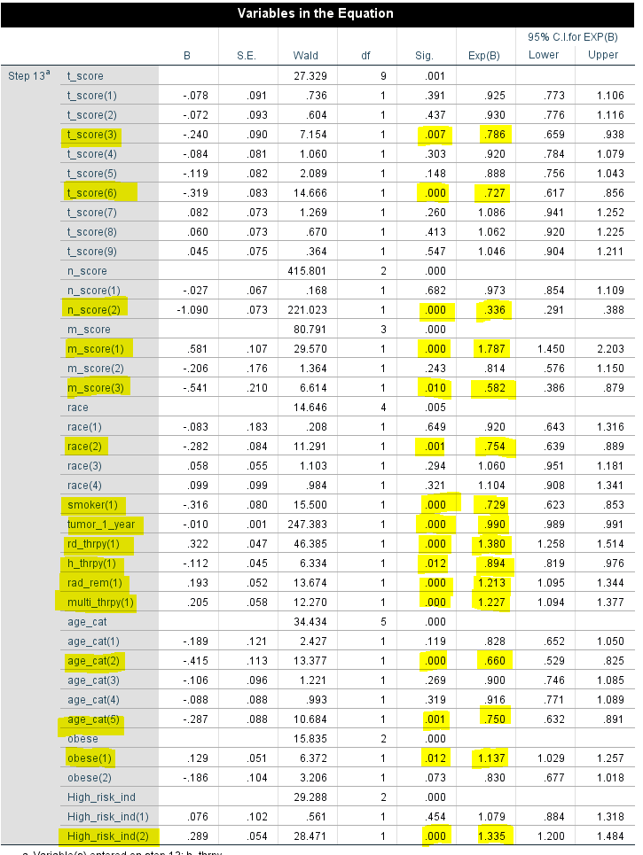
Forward Stepwise Logistic Regression:
The odds of survival after 7 years decreases 21.4% for those who have t_score = T2a as opposed to those whose t_score = T1a
The odds of survival after 7 years decreases 27.3% for those who have t_score = T3a as opposed to those whose t_score = T1a
The odds of survival after 7 years decreases 66.4% for those who have n_score= N1 as opposed to those whose n_score = N0
The odds of survival after 7 years decreases 66.4% for those who have n_score= N1 as opposed to those whose n_score = N0
The odds of survival after 7 years increases 78.7% for those who have m_score= M1a as opposed to those whose m_score = M0
The odds of survival after 7 years decreases 41.8% for those who have m_score= M1c as opposed to those whose m_score = M0
The odds of survival after 7 years decreases 24.6% for those who’s race code = 3 as opposed to those whose race code =1
The odds of survival after 7 years decreases 27.1% for those who is a smoker as compared to a non smoker
The odds of survival after 7 years increases 38% for those who has undergone external beam radiotherapy to those who have not
The odds of survival after 7 years decreases 10.6% for those who have undergone hormone therapy to those who have not

Slide 11
Forward Stepwise Logistic Regression:
The odds of survival after 7 years increases 21.3% for those who have their prostate surgically removed as opposed to those whose have not
The odds of survival after 7 years increases 22.7% for those who undergone multiple therapies removed as opposed to those whose have not
The odds of survival after 7 years decreases 34% for age category=2
The odds of survival after 7 years decreases 25% for age category=5
The odds of survival after 7 years increases 12% for those who are not obese as compared to those who are obese
The odds of survival after 7 years increases 33.5% for those who are not at high risk as compared to those who are at high risk

Slide 12
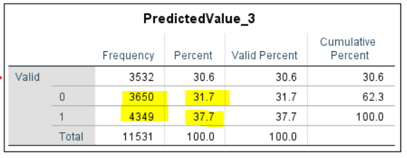
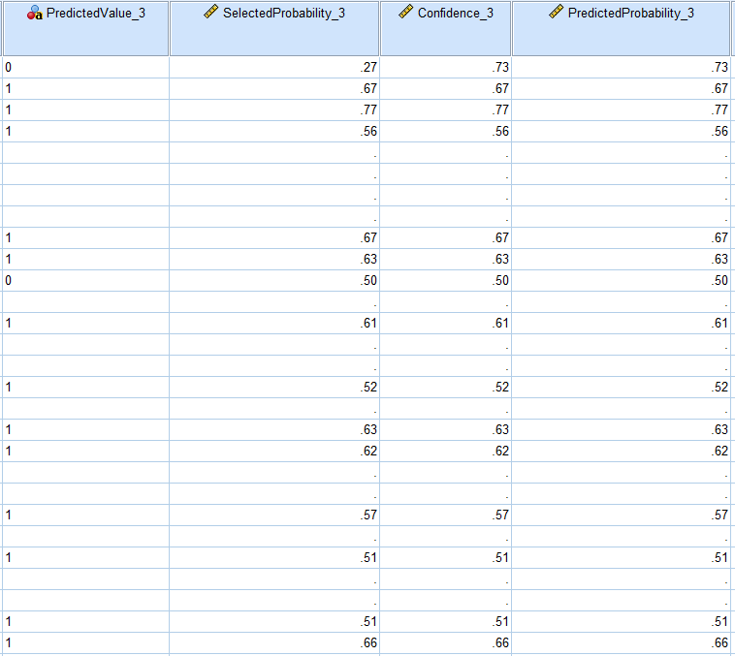
PREDICTION IN TEST DATA:
The model has predicted that 4349 Patients will be alive 7 years after diagnosis which is 37.7% of the test data population

